Slide 1


I have a heartbeat too…

Slide 2
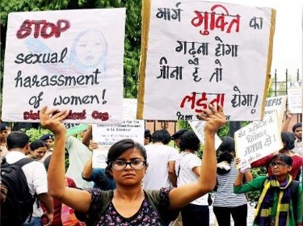
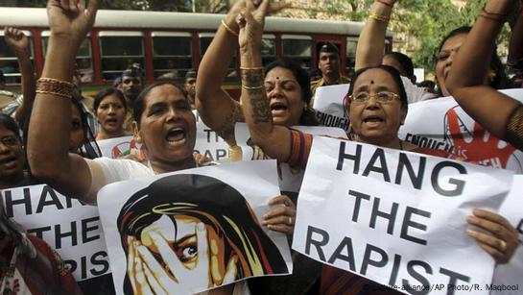
The Problem
Women’s safety is a critical concern in India.
Existing apps rely on manual SOS triggers (press buttons, shake phone).
Victim may not always access phone in danger.
Police response delays due to centralized routing.
LEARN NOW

Slide 3
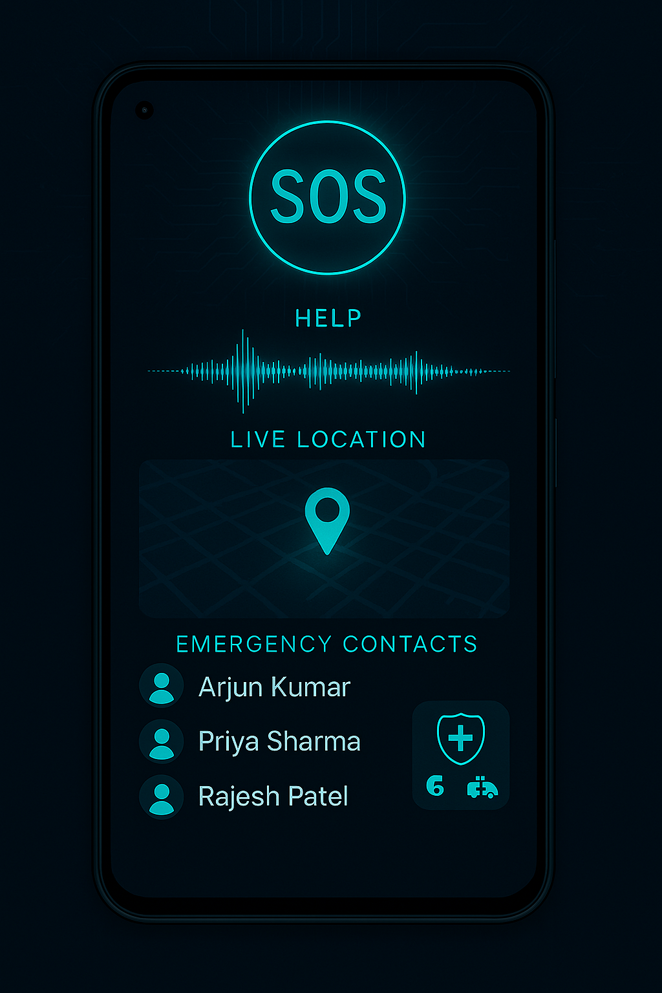
The Solution
Voice-activated distress detection (“Help”) at specific amplitude.
Automatic alerts to top 5 contacts (proximity-based).
Direct real-time alert to nearest police + ambulance.
Fake shutdown mode to protect victim.
Fake call feature for discreet evidence collection.
LEARN NOW

Slide 4

Key Features
Voice Triggered SOS – hands-free safety.
Fake Shutdown Mode – attacker proof.
Fake Call + Recording – discreet evidence capture.
Police Dashboard – instant response system.
Crime Analytics – automatic monthly reports.
LEARN NOW

Slide 5
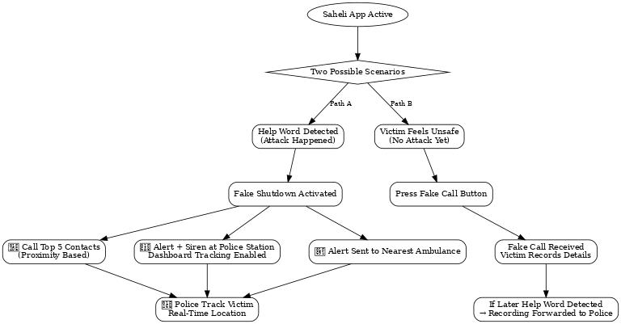
How It Works

Slide 6
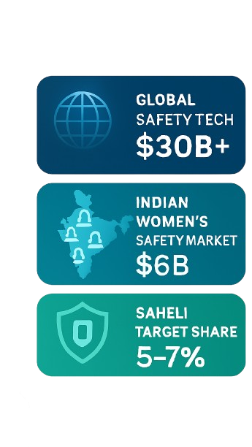
Market & Opportunity
Exploring the vast potential of Saheli
TAM
680M women in India – large potential user base.
Smartphone penetration > 75% among women.
Growing focus on women’s safety by Govt. & NGOs.
Global safety tech industry $30B+.
SAM
SOM

Slide 7
Competitive Landscape
Traditional Safety Apps | Saheli Advantage
Manual SOS triggers (button/shake/press). Delayed police routing. Limited features. | AI Voice SOS – automatic, hands-free trigger. Fake Shutdown Mode – attacker-proof safety. Fake Call + Recording – discreet evidence. Police Dashboard – instant real-time alerts. Crime Analytics – proactive prevention.

Slide 8




Target Users
Women & girls across India (urban + semi-urban) | Families monitoring loved ones.
Police departments, NGOs, city authorities. | College students, working women, metro city commuters.

Slide 9

Business Model
Partnerships – Tie-ups with Govt., Police, NGOs for adoption.
CSR/Grants – Corporate Social Responsibility & safety funds.
Freemium App – Free safety features + premium add-ons (family monitoring, advanced analytics).
Data Insights – Aggregated crime & safety data for city planning.
LEARN NOW

Slide 10

About Me
4th year student of engineering(Artificial Intelligence and Data Science)
Research Intern at Avignon University France.
Aegis Graham Bell Award from Government of India.
Awarded as Best Innovator During IDE Bootcamp From Ministry of Education.
Winner of Best AI Tech Project Award from Infosys India.
Represented India at International Hackathon in Slovakia, Europe
Winner of National & State-Level Hackathons
Sumit Kolpe
Vision: To make India the safest country for women by leveraging AI-powered technology that ensures immediate help, empowers victims silently, and enables authorities to prevent crimes through real-time intelligence.
LEARN NOW

Slide 11


Your safety, our priority.
Thank you...

